Slide 1
Online Registration App
Group 3

Slide 2
Introduction
online registration app for students from grade 1 to 12. This is the platform where Parents of guardian register their children to enroll in school.
The purpose of this app is to eliminate the manual registration process used in schools to save time and costs.
Monitor the performance of students in class or at school.

Slide 3
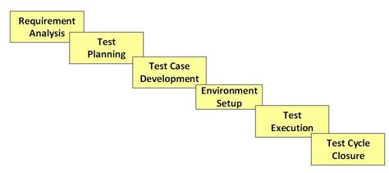
Software Testing Life Cycle
Software Testing Life Cycle (STLC) is a sequence of specific activities conducted during the testing process to ensure software quality goals are met. STLC involves both verification and validation activities.
There are following six major phases in STLC Model:

Slide 4
Phase #1 : Requirement Analysis
Testing Requirements
Our main priority testing is based on Security, Usability and Functionality testing.
E.g, Email Verification, Password Validations, Accessibility and responsiveness
User Stories
User must be able to register and verify their email address via link
User must be to create a Profile page /Update profile
User Should be able to select School where they want to enroll their children
User can register multiple children under their profile
User must be able to Upload documents
User must get a Confirmation message of whether the application was unsuccessful or not.

Slide 5
Phase #2 : Test Planning
Model | Waterfall is a sequential model that divides software development into pre-defined phases. Requirements are not changing frequently Application is not complicated and big Project is short Requirement is clear Environment is stable
Time Frame | 2 Weeks
Cost | R100 k
Stakeholders | System Admin, Developers, Testers

Slide 6
Test Planning Continue…
Testing tool | Selenium is the most popularly used freeware and open-source automation tool. The benefits of Selenium for Test Automation are immense. Importantly, it enables record and playback for testing web applications and can run multiple scripts across various browsers
Plan Tests | We must preform API testing, unit testing, integration testing and system testing for the following reasons: Api testing: Sending and receiving notification from users Unit testing: is done for module being tested i.e Personal details entity, child details etc. Integration testing: for integrating all modules System testing: for testing the entire software application prior deploy

Slide 7
Phase #3: Test case Development
Functional Testing: Testing the features and operational behavior of a product to ensure they correspond to its specifications.
Security Testing: Security Testing involves the test to identify any flaws and gaps from a security point of view.
Usability Testing: the application flow is tested so that a new user can understand the application easily.
Test Case type | Description | Test Step | Expected Results | Status
Functionality | Are should not contain numbers and Special Character | Input Name with and Without Numbers and Special character | All Characters in the request should be appropriate | Pass or Fail
Security | Verify Password rules are working | Create password in accordance with rules | The user’s password will be accepted if it adheres to the rules | Pass or Fail
Usability | Ensure all links are working Properly | Have users click on various links on the page | Links will take users to another web page according to the on page URL | Pass or Fail

Slide 8
Phase #4: Test Environment Setup
A testing environment is a setup of software and hardware for the testing teams to execute test cases.
Areas | Description
Test Server | Every test may not be executed on a local machine. It may need establishing a test server, which can support applications. Fedora set up for PHP, Java-based applications with or without mail servers
Network | Network set up as per the test requirement. It includes, Internet setup, LAN Wifi setup, Private network setup
Test PC | For web testing, we need to set up different browsers for different testers. For Mobile App, We need Xcode, Android Studio, simulator/ Emulator installed and alternatively Android and Apple Phone
Bug Reporting | Bug reporting tools should be provided to testers. We can use different bug tools like Jira etc.
Test Data | Testers or developers can copy Production data to their individual test environment. They can modify it as per their requirement. This helps the tester, to detect the same issues as a live production server, without corrupting the production data.

Slide 9
Phase #5: Test Execution
Understand the manual creating of the application
Record the creation of the application using a browser-based tool e.g selenium etc.
Write a test suite that will create an online application.
Map defects to test cases in Requirement Tracing Matrix (RTM)
Document test results, and log defects for failed cases
Deliverables
Completed RTM with the execution status
Test cases updated with results
Failed test were reported to developers using bug reporting tool e.g. JIRA

Slide 10
Phase #6: Test Closure
Project was done on given budget
Project was completed in due time
All User requirements were Met
User can register and Login to App
User can upload documents
User can create profile
User can enroll multiple children under one profile

Slide 11
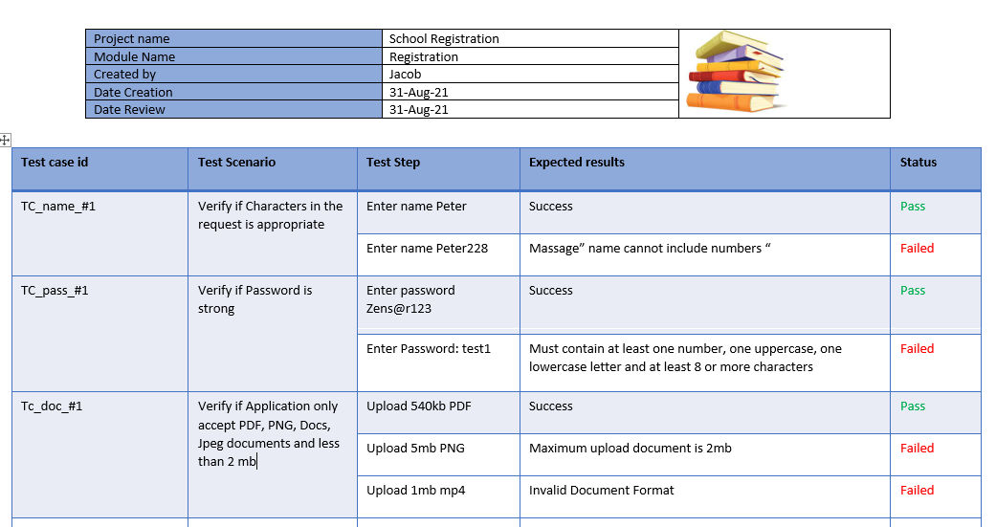
Test Summary
All test cases were done, and all defects were reported and resolved / fixed

Slide 12
Software testing Conti……

Slide 13
What is Kanban?
Kanban is a visual system for managing work.
It visualizes both the process and the actual work passing through that process.
The main objective of implementing Kanban is to identify potential bottlenecks in the process and fix them.
Kanban goal is that workflow should proceed smoothly at an optimal speed.
Notes:
The Kanban Method is a means to design, manage, and improve flow systems for knowledge work. The method also allows organizations to start with their existing workflow and drive evolutionary change. They can do this by visualizing their flow of work, limit work in progress (WIP) and stop starting and start finishing.

Slide 14
Why Kanban?
Kanban methodology is designed to meet minimal resistance
Kanban boards allow visual management of software development project work.
Kanban boards prove effective as it helps team members to become more productive while reducing the amount of workload stress that project managers and team members feel during a project lifecycle.
Kanban software development method should be implemented if the team has a process which works fine but still needs some optimization.
Notes:
Kanban methodology is designed to meet minimal resistance. So it allows continuous small incremental and evolutionary changes to the current process. It also helps to achieve improvements regarding throughput, lead time and quality.
Kanban boards allow visual management of software development project work. This helps team members to see work in progress. It also helps them to understand complex information like processes and risks associated to complete work on time.
Kanban boards prove effective as it helps team members to become more productive while reducing the amount of workload stress that project managers and team members feel during a project lifecycle.
Kanban software development method should be implemented if the team has a process which works fine but still needs some optimization. Kanban process allows them gradually improve all their tried and tested process.

Slide 15
Kanban Process
Four principles of the Kanban Method
Visualize Work
By creating a visual model of work and workflow, It helps to observe the flow of work moving through the Kanban system.
Limit work in process
It allows team members to decrease the time taken by item to travel across the Kanban system.
Focus on flow
By using work-in-process limits and developing team-driven policies, you can optimize Kanban system to improve the smooth flow of work.
Continuous Improvement
When Kanban system is in place, it acts as a foundation for a continuous improvement. It helps teams to measure their effectiveness by analyzing tracking flow, quality lead times, etc.
Notes:
In the Kanban process, everything is gradually improved whether it is software development, Staffing, Marketing, Sales, Procurement, etc. The Kanban Method follows a certain set of principles for managing and improving the flow of work.
There are four principles of kanban
1 Visualize Work or workflow
By creating a visual model of work and workflow, It helps to observe the flow of work moving through the Kanban system.
2 Limit work in process
It allows team members to decrease the time taken by item to travel across the Kanban system.
You can Set a limit on how much work can be in progress at one time in each column. In other words, how many cards can be in each column at a given time. This ensures that cards are moving smoothly across the board as and when the team are ready for them.
3 Focus on flow
By using work-in-process limits and developing team-driven policies, you can optimize Kanban system to improve the smooth flow of work.
By now, your work should flow freely through the Kanban system. It might even feel very easy! Make sure that you keep a lookout for any interruptions in flow and use these as opportunities for improvement. Workflow should run smoothly and not stop and start.
4 Continuous Improvement
When Kanban system is in place, it acts as a foundation for a continuous improvement. It helps teams to measure their effectiveness by analyzing tracking flow, quality lead times, etc.
Remember that even after implementing Kanban, the work is never truly finished. Part of the Kanban method is to continuously improve your processes. Monitor your Kanban system and make improvements on an ongoing basis.

Slide 16
Test cases
Test Case type | Description | Test case Step | Expected results | status
Functionality | Only create one user account | Try to recreate a user account using the same credentials of an existing user account | Display a message “ User already Exists” | Pass or Fail
Functionality | When a user selects a grade 1-9 it should automatically populate the subjects for that grade | Select any Grade between 1 - 9 | Populates subjects for that grades | Pass or Fail
Functionality | A user must be able to select subjects as per group if the child is registering for grade 10, 11, and 12 | Select a Grade between grade 10 and 12 | Populate different Grouped of subjects | Pass or Fail
Functionality | when a user selects a country of origin then it should allow you to put your Id or passport number according to your country of origin | Select a country e.g South Africa. | South African ID valid text box | Pass or Fail

Slide 17
Test Cases Conti…
Test Case type | Description | Test case Step | Expected results | status
Functionality | A user should able to add new applications | Click the add button | Open a new form to add new applicant | Pass or Fail
Functionality | A user should be able to update their application information | Click update or edit button | Populate a form with existing information that you can override | Pass or Fail
Functionality | A user should be able delete an applicant | Click on the delete button | Pop up a message asking “Are you sure you want to delete” “Yes or No” | Pass or Fail
Functionality | A user should not be able to click submit without filling all the required fields | Click on the submit | A button must be graded out or disabled until user complete form. | Pass or Fail
Security | A user should not be able to pass the Sql injection test | Insert a sql injection query | Invalid information | Pass or Fail
compatibility | The app should be able to open on any browser | Use different platform to open the app | It should opened on any given browser or platform | Pass or Fail

Slide 18
Kanban Board
See Trello

Slide 19
Thank you
Questions go to www.google.com

